Slide 1
Video classification using Neural Networks
Database used: Youtube-8M Database
ML Models Implemented: Logistic Regression, LSTM
ML Libraries used: TensorFlow, Scikit-Learn, Kaggle kernel, Ipython Kernel
Visualization Tools used: Tensor-Board, matplotlib
Nitish Gaddam
Boston University
MET CS 767 - Machine Learning

Slide 2
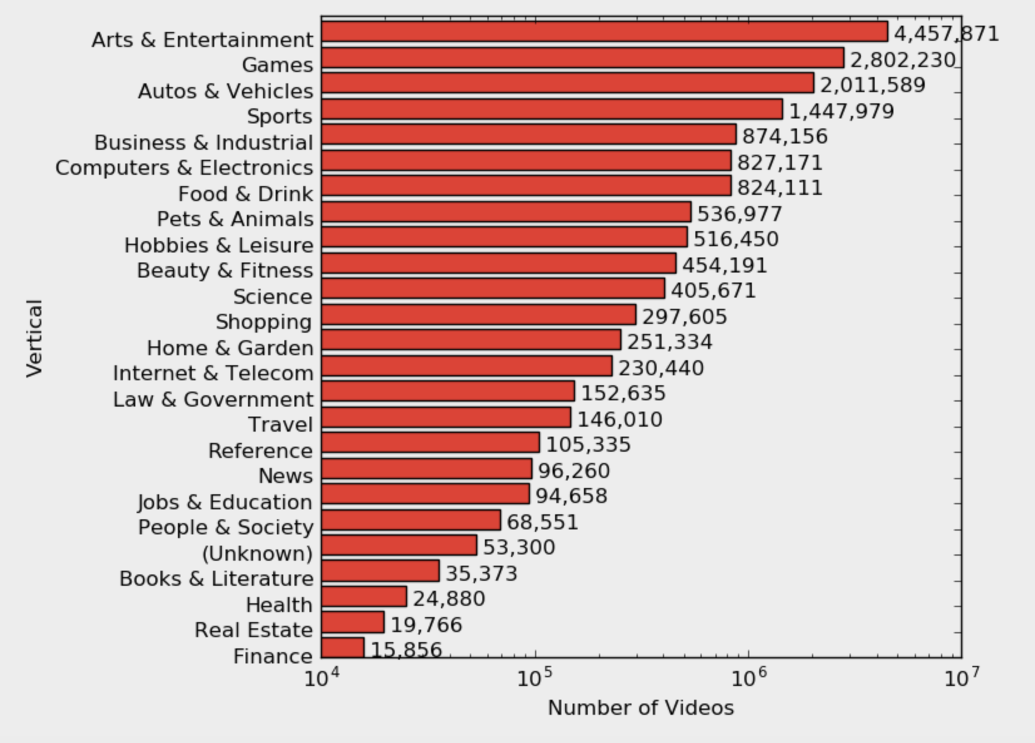
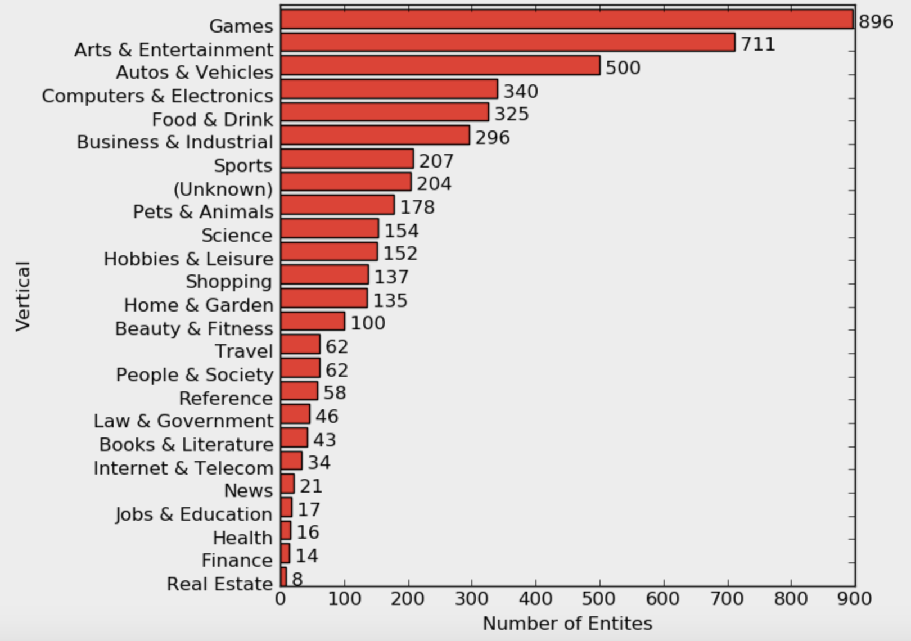
Description
Youtube-8M (V.2) Dataset
7 Million individual videos with half a million hours (~50 yrs.)
Complexity and ambiguity of the interrelations between linguistic terms and audio-visual content of the video.
3.4 Avg Labels per video
The target annotation vocabulary consists of 4716 Knowledge Graph entities
Includes both coarse and fine-grained entities
These entities have been semi-automatically curated and manually verified by 3 raters to be visually recognizable.

Slide 3
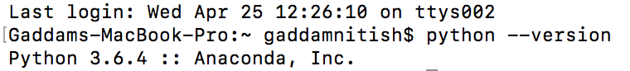


Requirements
Python 2.7+
TensorFlow 1.0.0 or higher
Memory Allocation for Data
import numpy as np # linear algebra
import pandas as pd # data processing, CSV file I/O (e.g. pd.read_csv)
from matplotlib import pyplot as plt #e.g., creates a figure, creates a plotting area in a figure, plots some lines in a plotting area, decorates the plot with labels, etc.
from keras.models import Sequential # Sequential model is a linear stack of layers
from keras.layers import Dense # Just your regular densely-connected NN layer.
from keras.layers import LSTM # Long Short-Term Memory layer

Slide 4
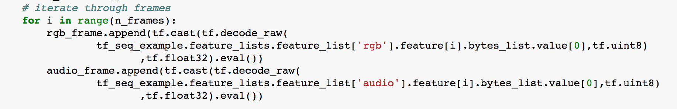
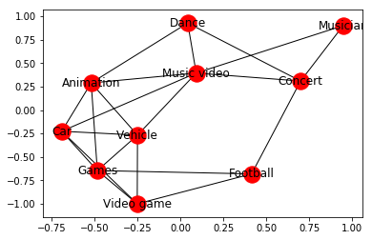
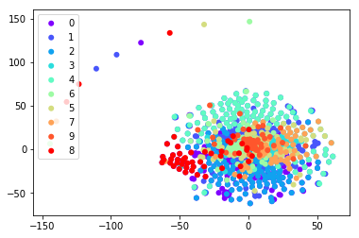
Design Phase 1
Import the Database as a TensorFlow record
Understand the design of each record and analyze both audio and video-level features
draw_network is a technique to draw a graph with Matplotlib with options for node positions, labeling, titles, and many other drawing features.
t-Distributed Stochastic Neighbor Embedding (t-SNE) is a technique for dimensionality reduction that is particularly well suited for the visualization of high-dimensional datasets.

Slide 5
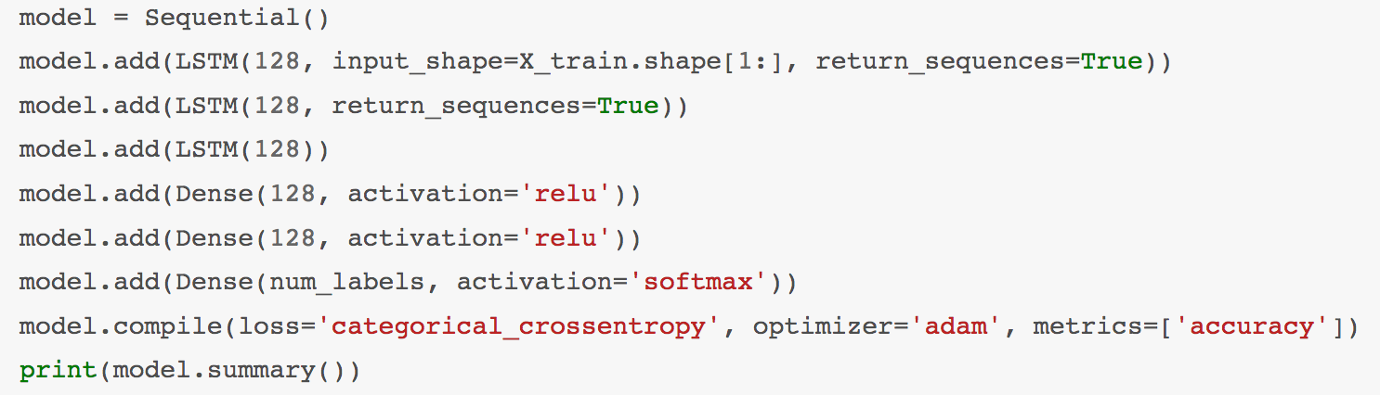
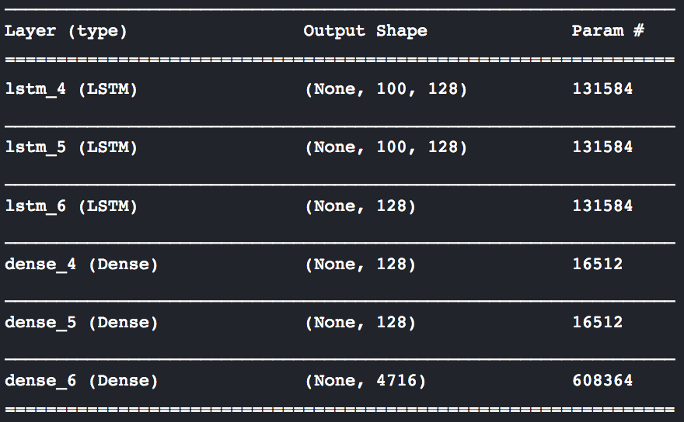


Design Phase 2
Let’s read the frame-level data due to execution time, we're only going to read the first video
Now, we add our Neural Network layers. We start the training with a few LSTM layers, following which we use a few Dense layers. Here we use relu and softmax activation functions.
now, let's read the frame-level data due to execution time, we're only going to read the first video, now, let's read the frame-level data due to execution time, we're only going to read the first video
Notes:
Softmax function is typically used only in the output layer of a neural net to represent a probability distribution of possible outcomes of the network.
Relu or rectified linear is a popular variant of activation functions esp in deep convolutional nn to impose non linearity to the incoming activations.
The typical cost function that one uses in logistic regression is computed by taking the average of all cross-entropies in the sample. The logistic loss is sometimes called cross-entropy loss.
Adam is an optimization algorithm that can used instead of the classical stochastic gradient descent procedure to update network weights iterative based in training data.
Model.Fit - Trains the model for a fixed number of epochs

Slide 6

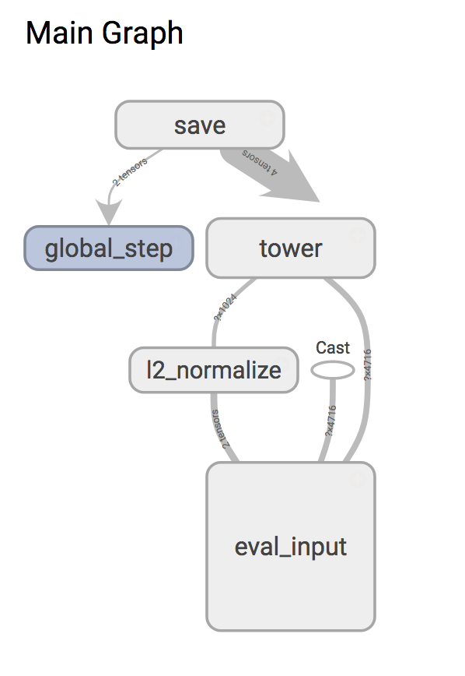


Design Phase 3
Training on Video-level features
Evaluation and Inference
View the result on Tensorboard
Navigate to http://localhost:6006 to view results on TensorBoard

Slide 7
Demo
Phase 1 Demo
Import one Frame of Data
Explore the Data
Phase 2 Demo
Implement an LSTM on the Frame level data obtained from Phase 1
Phase 3 Demo
Import all the Frames from the Youtube-8M Dataset
Train the data on a Logistic Model
Evaluate and infer this model
Connect the model to TensorBoard and view the results obtained

Slide 8
What did not work and why
Could implement the LSTM on a single Frame using a kernel, but could not implement it on the entire Dataset.
Machine Limitations caused trouble because of vast training time and limited cloud resources.
Tried to implement a Flask application using the trained data obtained to show real time video classification.

Slide 9
What worked
Could understand and separate frame-Level, audio-level, video-level data.
Visualized the data available successfully
Implemented Dense NN and LSTM on the Data
Trained and evaluated large scale data using Logistic Regression Classifier
Visualized the obtained model on TensorBoard

Slide 10
Questions as time allows
Thank you!!

